Slide 1
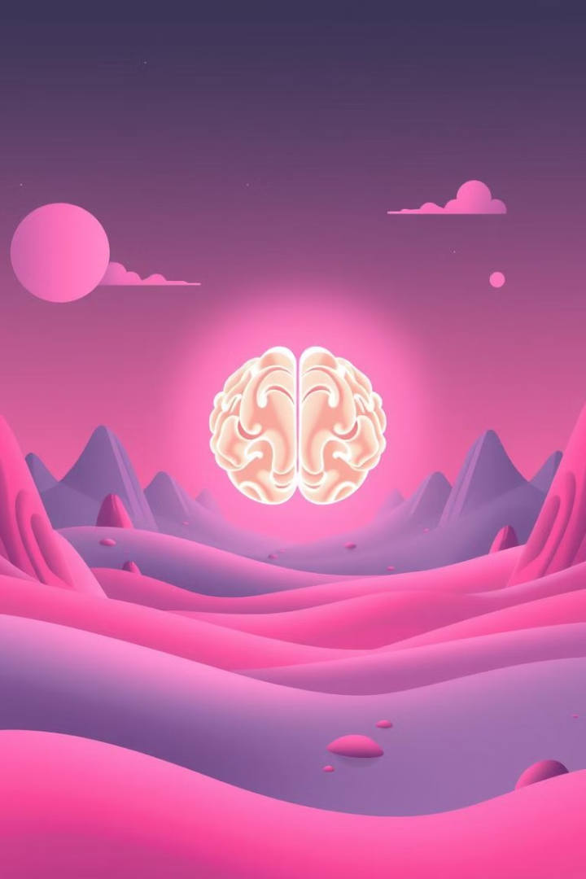
AI Mental Health Chatbot: NLP and Web-Based Support
Explore the potential of AI chatbots to provide accessible and immediate mental health support. This presentation outlines the technology, ethical considerations, and future development of a web-based AI mental health assistant.
SG
by Sivaperumalraj G

Slide 2

The Mental Health Crisis
Global Impact
Accessibility Gap
Approximately 8% of the global population struggles with mental health impairments.
There's a shortage of therapists. One therapist exists for every 1,600 patients suffering from depression/anxiety.
Unmet Needs
Over 80% of individuals with mental health concerns never receive professional assistance.

Slide 3
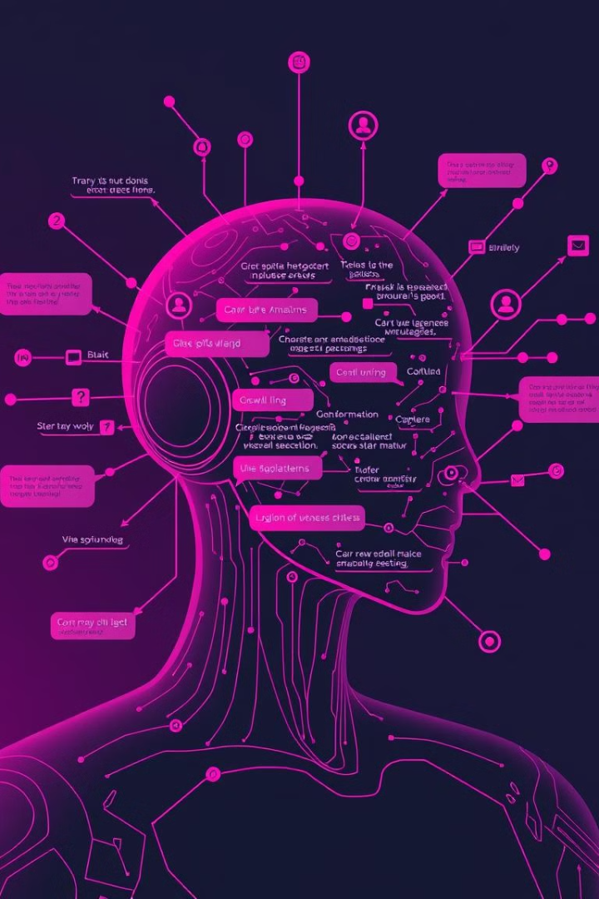




NLP and Chatbot Architecture
NLP Core
Machine Learning
Regex
Natural Language Processing is the central technology.
Regular expressions are used for intent matching.
Machine learning provides contextual understanding.
Web Interface
A web-based interface ensures easy access for users.

Slide 4





Conversational Design Strategies
Goal-Oriented
The system uses a goal-oriented dialog model for effective interactions.
CBT Principles
Cognitive Behavioral Therapy (CBT) principles are integrated into the design.
Personalized
The chatbot generates personalized responses based on user input.
Contextual
The system maintains contextual awareness and conversation tracking.

Slide 5
Technical Implementation
Dialog Management
Language Models
Secure Platform
Intent Recognition
GPT-based language models generate appropriate responses.
Secure web platform architecture protects user data.
DialogFlow and Rasa manage conversations and user flow.
A multi-stage intent recognition system accurately identifies user needs.

Slide 6

Ethical Considerations
User Privacy
Prioritize user privacy protection.
Crisis Intervention
Implement protocols for crisis detection and intervention.
Transparency
Communicate AI limitations clearly.
Professional Support
Emphasize that AI is not a replacement for professional mental health care.

Slide 7




Potential Impact
Reduced Barriers
Reduces barriers to accessing initial mental health assistance.
Symptom Tracking
Facilitates symptom tracking and early intervention.
24/7 Support
Scalable Resource
Provides round-the-clock availability of mental health support.
Offers a scalable mental health resource for large populations.
2
3
1
4

Slide 8
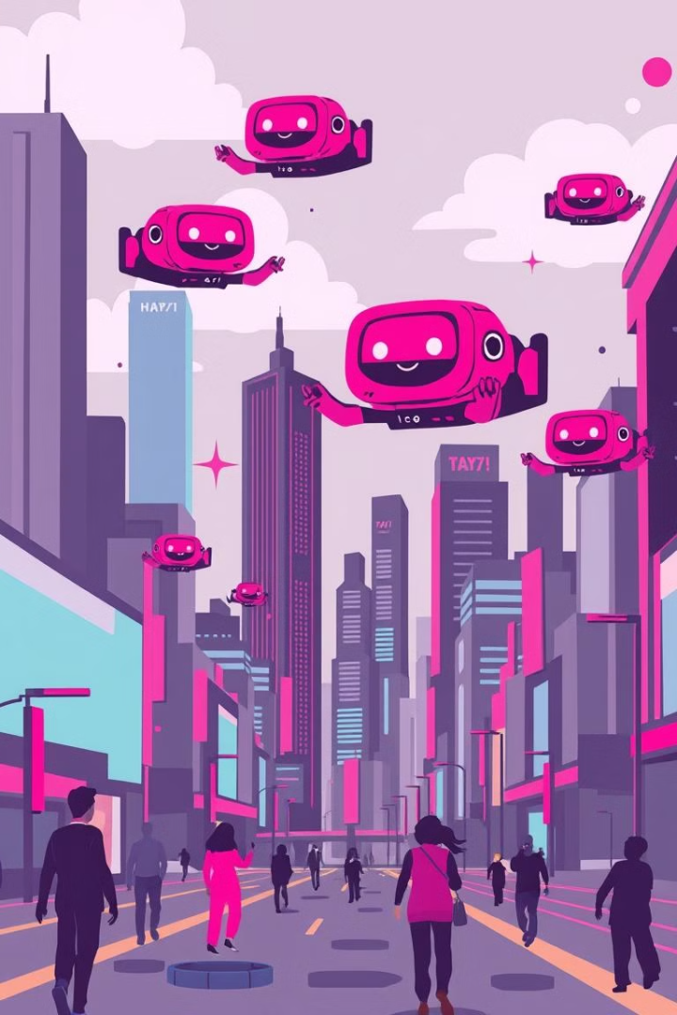
Future Development
Model Improvement
Continuously improve the chatbot model and its capabilities.
Enhanced Personalization
Offer enhanced personalization features for individual needs.
Professional Integration
Integrate with professional care networks for comprehensive support.

